Slide 1

Semester Project Robotic assembly of large-scale timber structures
Ibois
Genilloud Florian
05.11.2020
École Polytechnique Fédérale de Lausanne (EPFL)
Ibois
Assistant: Nicolas Rogeau
Professor: Pr. Yves Weinand
Ecole Polytechnique Fédérale de Lausanne

Slide 2
Content
Ibois
What is done
Yaw rotation with image processing
First prototype of implementation
Setup of the Raspberry Pi and remote control
What is left
Implementation of TOF sensors on the Ras.P
Separate measures of each sensors
Distance, Pitch and Roll
Add the module on the robot
Conclusion
Ecole Polytechnique Fédérale de Lausanne

Slide 3
What is done
Ibois
Ecole Polytechnique Fédérale de Lausanne

Slide 4
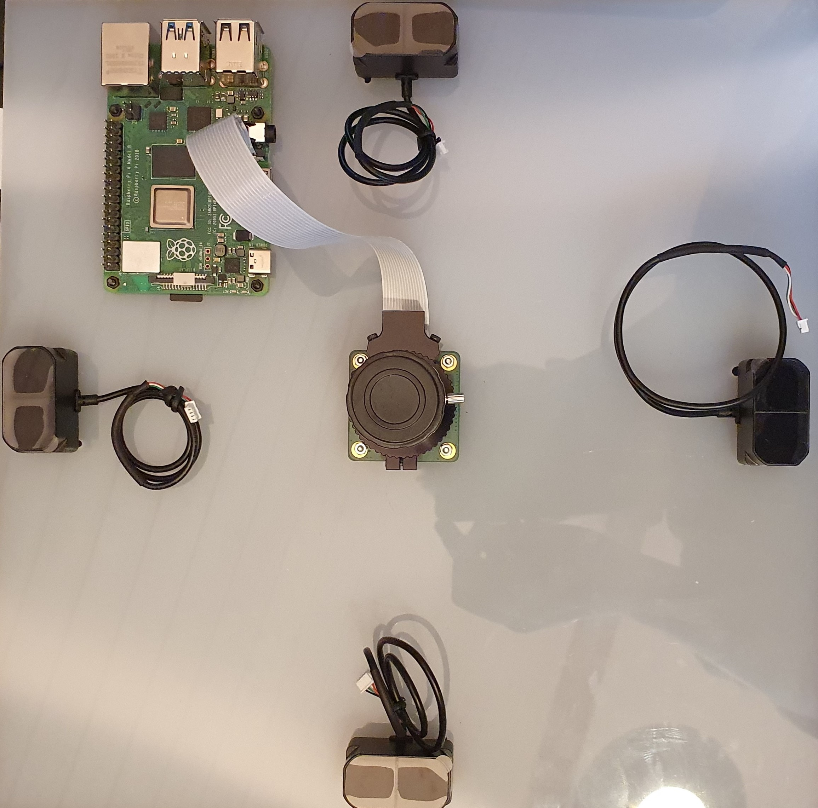
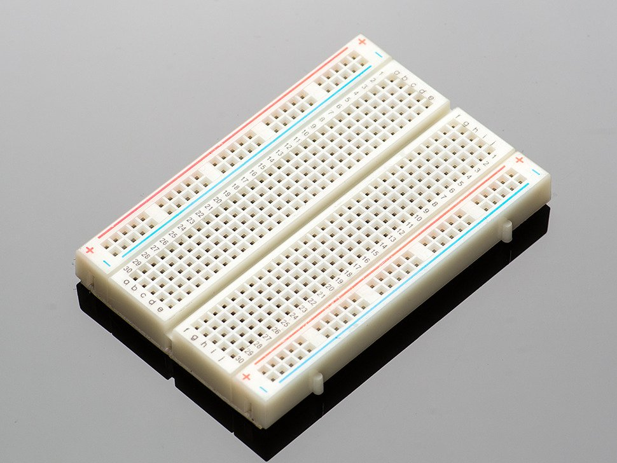
Material
Ibois
Selected Hardware:
Raspberry pi
Raspberry pi HQ Camera 12,3 MPx
TF mini plus TOF sensors
Needed Hardware:
Breadboard
Connections wires
Maybe an Arduino
Some basic electronic units
Ecole Polytechnique Fédérale de Lausanne

Slide 5
Idea of the algorithm for yaw
Ibois
Robotic assembly of large-scale timber structures
Image processing with Open-cv
Get the edges of the image
Compute the lines with the edges
Get the angle between the lines and the border of the image
Compute the yaw angle with some robustness
Can detect more natural structures than arUco
Ecole Polytechnique Fédérale de Lausanne

Slide 6
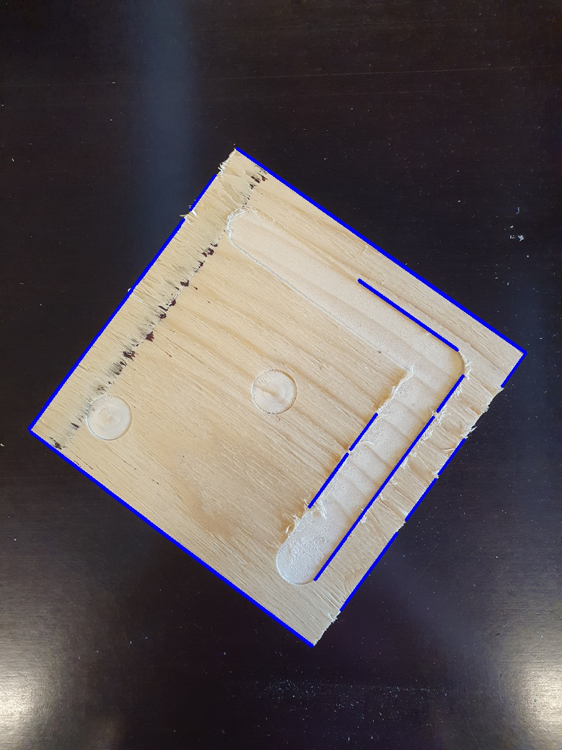
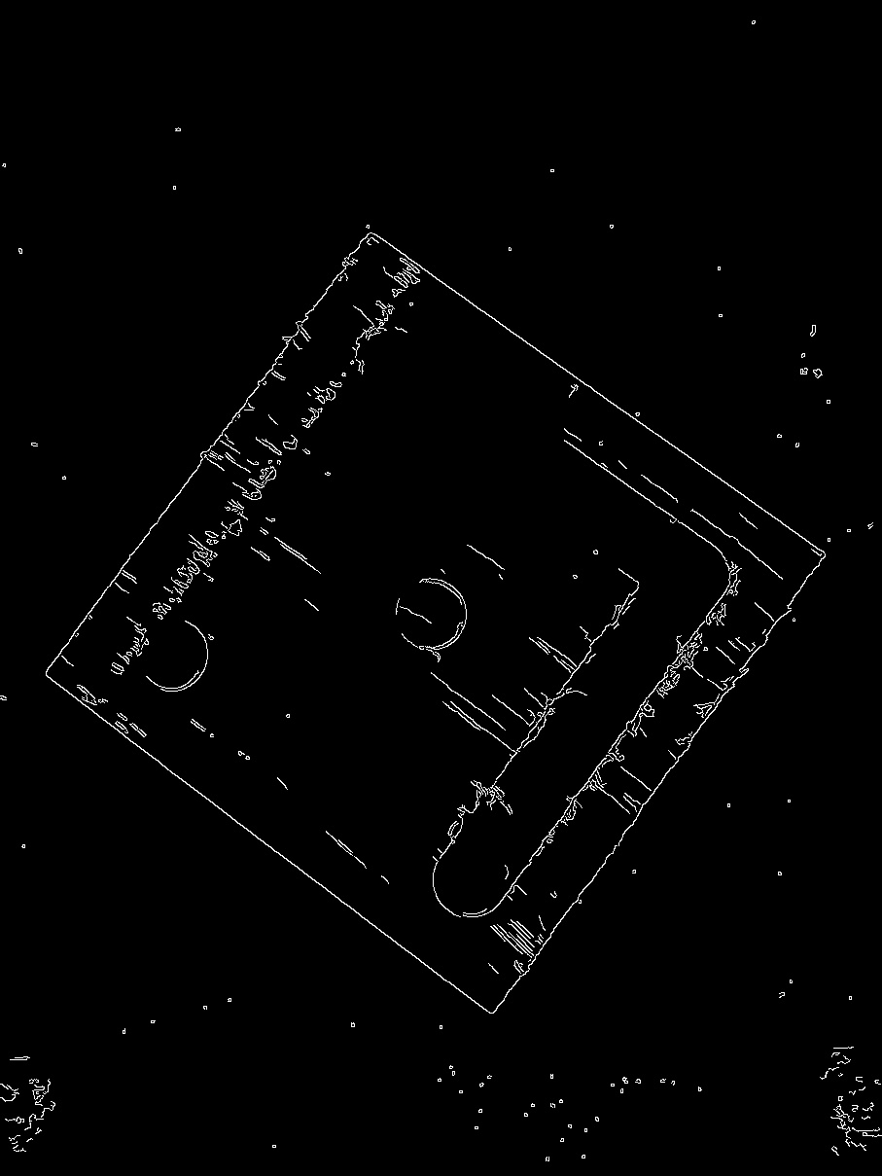
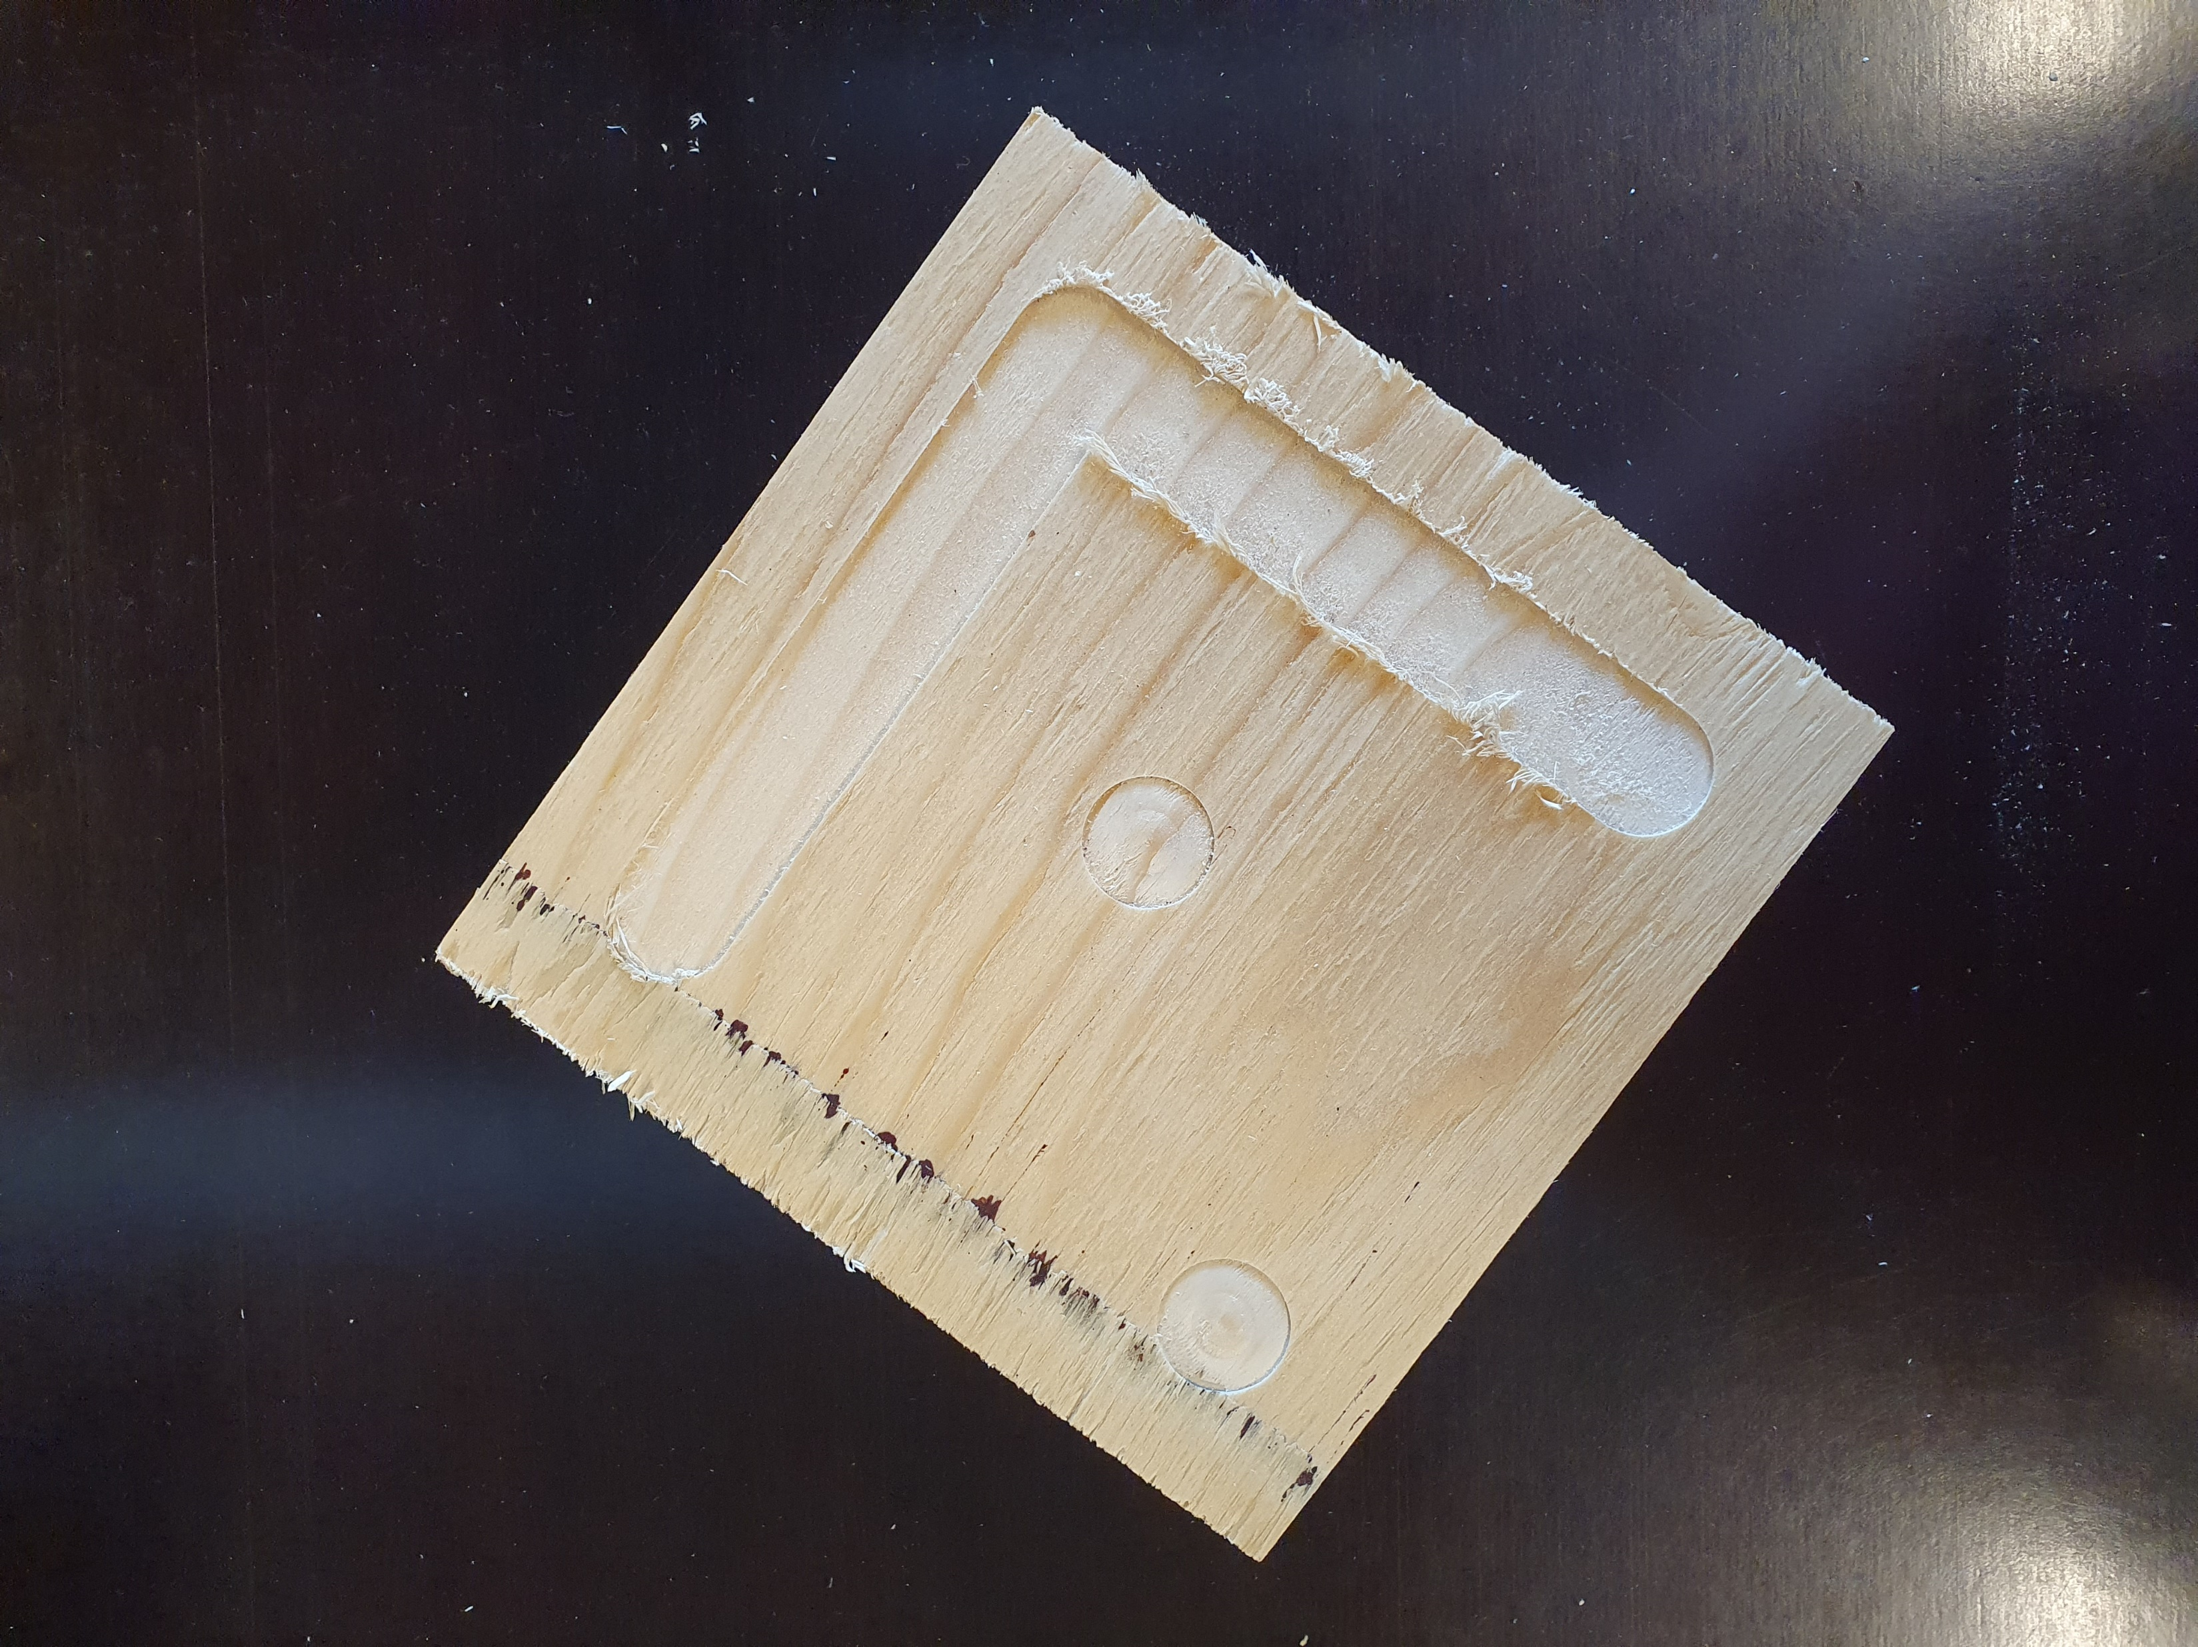
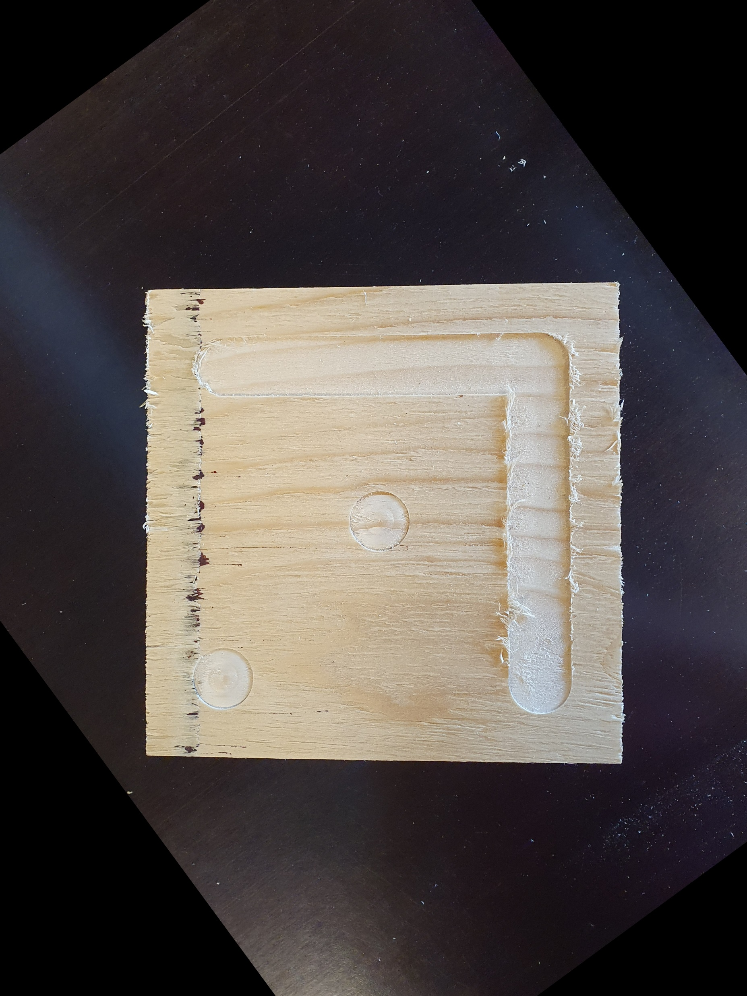
Yaw rotation with image processing
Ibois
Robotic assembly of large-scale timber structures
Ecole Polytechnique Fédérale de Lausanne

Slide 7
First prototype of implementation
Ibois
The idea is to have a clear define support in which we know the position of each element.
Relative position between the support and the robot head
3X3 coordinates of the plate with TOF sensors to compute pitch and roll
7
Ecole Polytechnique Fédérale de Lausanne

Slide 8

First prototype of implementation
Ibois
8
Ecole Polytechnique Fédérale de Lausanne

Slide 9
Setup of the Raspberry Pi and remote control
Ibois
Can have access to the raspberry pi using VNC or SSH
Can send data from raspberry pi to a remote computer using web.py
We can compute all the angles on raspberry pi then send them to the robot computer ☺
9
Ecole Polytechnique Fédérale de Lausanne

Slide 10
What is left
Ibois
Ecole Polytechnique Fédérale de Lausanne

Slide 11
Implementation of TOF sensors in the Ras.P
Ibois
Already have the code to use 1 sensor on raspberry pi
Need to test it when I will have the breadboard
Need to calibrate it
11
Ecole Polytechnique Fédérale de Lausanne

Slide 12
Separate the measure of each sensor
Ibois
Raspberry Pi can communicate with only 1 sensor at a given time
Need to add a second controller ( maybe Arduino ) to takes the 4 values needed
12
Ecole Polytechnique Fédérale de Lausanne

Slide 13
Separate the measure of each sensor
Ibois
t1
TOF 1
t2
TOF 2
t5
Time discriminative unit (Arduino)
t3
Send value to the raspberry py
TOF 3
t4
TOF 4
13
Ecole Polytechnique Fédérale de Lausanne

Slide 14
Distance, Pitch, Roll
Ibois
The TF mini plus directly compute and return the distance
Algorithms exist to compute pitch and roll using 3D coordinates ( we know X and Y from the position of the sensors).
Need to test it on the robot to calibrate
14
Ecole Polytechnique Fédérale de Lausanne

Slide 15
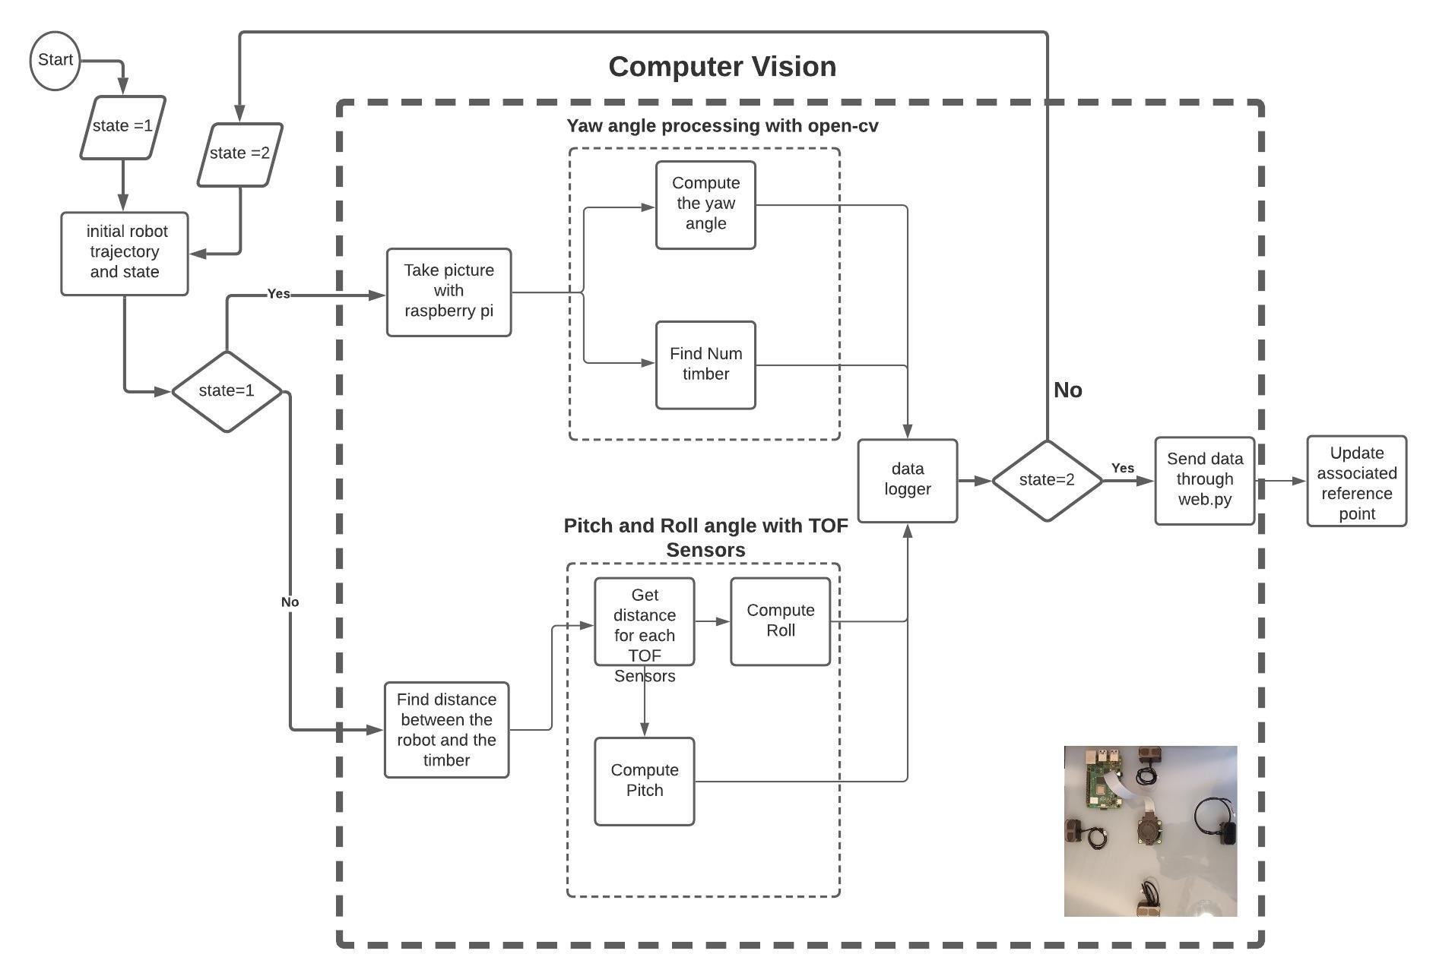
Add the module on the robot
Ibois
Need to precisely fixed the module on the robot to be as precise as possible
Need to add all the processing of the computer vision in the process
Need to protect the hardware with a suitable case
15
Ecole Polytechnique Fédérale de Lausanne

Slide 16
Questions ?
Ibois
Robotic assembly of large-scale timber structures
Thank you for you attention
Ecole Polytechnique Fédérale de Lausanne

